Slide 1
About
Education
Work Experience
Work Examples
Contact
ONLINE PORTFOLIO
BY JOYCE PICKERING
Instructional Design
Technical Writing
LMS Administration
Content Creation

Slide 2

About
Education
Work Experience
Work Examples
Contact
ABOUT ME
I am an accomplished Learning and Development Professional with over four years of experience in designing and implementing effective training programs. With a strong background in instructional design, I have successfully developed engaging e-learning courses and technical documentation that enhance compliance and operational efficiency across diverse organizations. Proficient in managing Learning Management Systems (LMS) like Cornerstone and Alchemy.
In addition to technical expertise, I excel in collaborating with subject matter experts to create tailored training solutions that meet the specific needs of various departments. My experience spans roles as a Training and Safety Specialist, Plant Training Coordinator, and Technical Writer, where I have demonstrated a commitment to continuous improvement and employee development. With a Master’s degree in Learning Experience Design and Technology, along with several relevant certifications, I am dedicated to leveraging advanced instructional strategies and technologies to foster a culture of learning and growth within organizations.
JOYCE PICERKING

Slide 3
About
Education
Work Experience
Work Examples
Contact
EDUCATION HISTORY
WESTERN GOVERNORS UNIVERSITY
IDOL ACADEMY FOR INSTRUCTIONAL DESIGN
KEAN UNIVERSITY
M.S. in Learning Experience Design and Technology
Instructional Design
B.A. in Communications
Additional Certifications
AI-Powered Instructional Design Professional Certification LearnWorlds
Procuring Section 508 Conformant ICT Products and Services Certification US General Services
Foundations of Accessible Learning LinkedIn Learning
Online Portfollio

Slide 4
About
Education
Work Experience
Work Examples
Contact
2024
TECHNICAL WRITER
(CONTRACT)
  Ensured all documentation is compliant with industry standards and best practices.
  Edited and proofread technical documents for clarity, consistency, and accuracy.
  Reduced the overall workload for the conversion project by 40%.
JOB EXPERIENCE
2023/2024
TRAINING AND SAFETY SPECIALIST
  Implemented and managed annual training programs and increased compliance rates from 20% to 85%.
  Administered and managed the Learning Management System (LMS) while maintaining training records for e-learning and live training sessions across the company.
  Developed instructional technical videos utilizing Canva detailing the installation process for elevator lifts.
Skills:
  Technical Writing
  SME Management
  Instructional Design
  Needs Analysis
  ILT and VLT Presentations
  LMS Administration
  Curriculum Development
  Project Management
  Documentation Management
  Adult Learning Theories
  Human-Centered Design
  WCAG and Section 508
Technology:
  Articulate Storyline
  Rise
  Genial.ly
  MS Office
  Capcut
  Camtasia
  Snagit
  Adobe Captivate
  Artificial Intelligence (AI)
  Video and Audio Editing
  VEED
  Vyond
  LMS (iSpring, Alchemy, Cornerstone)
2022/ 2023
PLANT TRAINING COORDINATOR
  Managed Alchemy and Cornerstone LMS and SharePoint sites and provided reporting.
  Transformed new hire orientation training into a comprehensive program that equipped employees with essential food production floor skills.
  Scheduled and led instructor-led training for 20-30 new hires during orientation.
  Conducted needs and skill analysis to uncover additional business support opportunities.

Slide 5

About
Education
Work Experience
Work Examples
Contact
Example # 1 : Employee Observation Training
The Problem :
The supervisors currently in place felt that they did not have the proper training and tools to conduct observations correctly. They expressed concerned that they would be accused of favoritism or discrimination. Their request was to have a training that walked through the observation process and provide guidance on how to conduct it without bias.
The Design Process :
Using Human-Centered Design, a framework was built out in order to decide the best way to present the information in a logical and scaffolding manner. Emphasis was to provide real life examples of what the supervisors would encounter and how to deal with each situation.
Joyce Pickering
The Solution :
Using Human-Centered Design, a framework was built out in order to decide the best way to present the information in a logical and scaffolding manner. Collaboration with SMEs was necessary to provide scope and “tribal knowledge”.
Technology :
PowerPoint, Canva

Slide 6
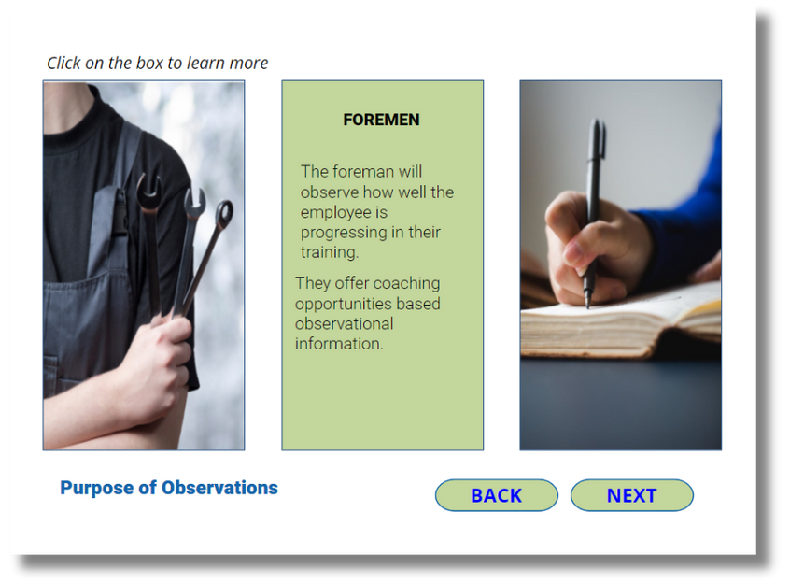
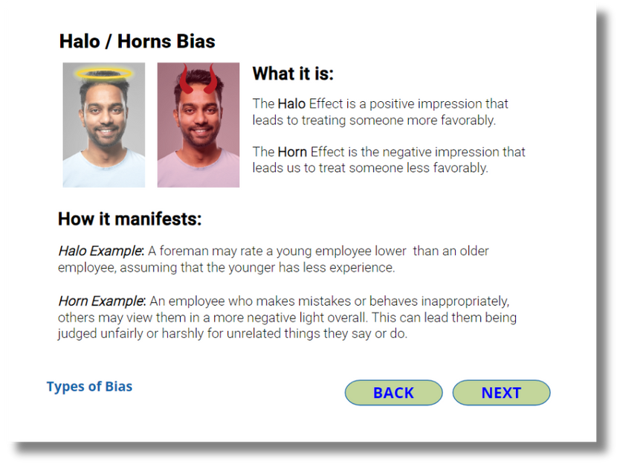
About
Education
Work Experience
Work Examples
Contact
Example # 1 : Employee Observation Training
Joyce Pickering
Joyce Pickering

Slide 7

About
Education
Work Experience
Work Examples
Contact
Example # 2 : SAE and Metric Equipment Training
The Problem :
Technicians were using the wrong tools to secure lifts to the ground, leading to stripped bolts, unstable posts, and higher labor costs. To address this issue, a training program was developed to educate technicians on the various types of bolts and the appropriate tools for their installation.
The Design Process :
The focus was to provide a overview of the differences and then provide real world examples of how the bolts are to be properly used. Use of specific images, custom graphics and videos helped support the learning objects of the course.
Quizzes were placed after every module to reinforce the information that was previously presented.
The Solution :
After the course was rolled out the company technicians, the instances of calls regarding stripped bolts or concrete pads due to improper bolt placement dropped from 65% to 25%.
Technology :
Articulate Storyline, Canva, Youtube

Slide 8
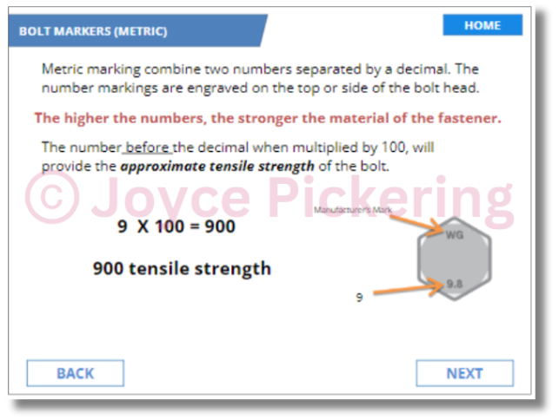
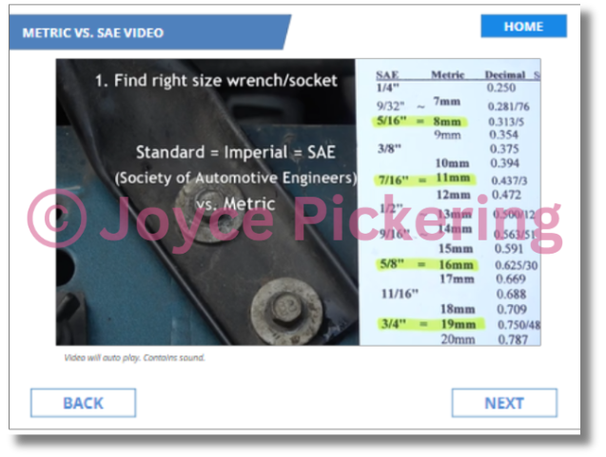
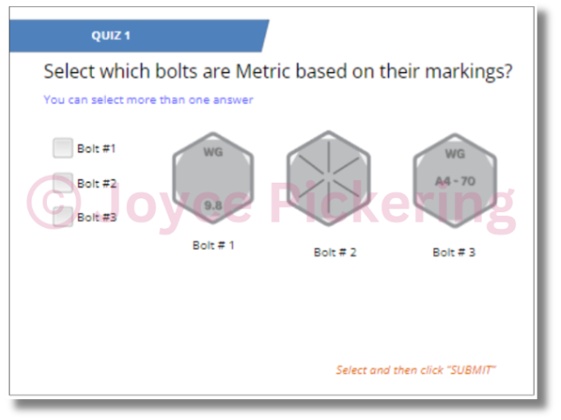
About
Education
Work Experience
Work Examples
Contact
Example # 2 : SAE and Metric Training

Slide 9

About
Education
Work Experience
Work Examples
Contact
Example # 3 : Chemical Anchors
The Problem :
Technicians were using chemical anchors incorrectly and/or for the wrong applications. This caused a profound uptick in installation costs. The objective of the training was to explain the proper use of chemical anchors and the situations where they are to be used.
The Design Process :
Consulting with SME, as well as researching the Safety Data Sheets (SDS) for the anchors used. A generalized training was created with the emphasis on the technician to confirm proper usage for each brand. Using Human-centered design and ADDIE, a framework of instruction was created.
The Solution :
Utilizing a combination of video, graphics and safety data sheet imagery, the course was designed to explain the pro[per installation of the anchors , many which could not be seen when installing. Emphasis was made to education the technician on the proper application temperatures and cure times. As a result, unnecessary applications of chemical anchors dropped by 10% in the first week after the training was presented.
Technology :
Canva, Articulate Storyline, YouTube, Safety Data Sheets

Slide 10
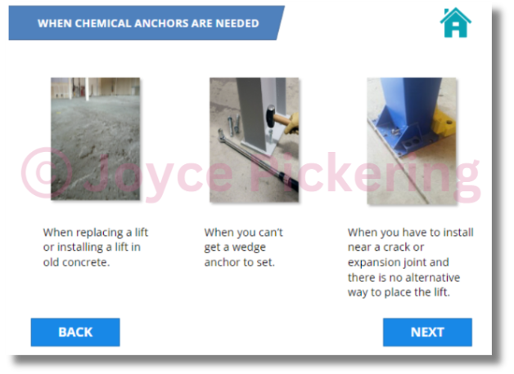
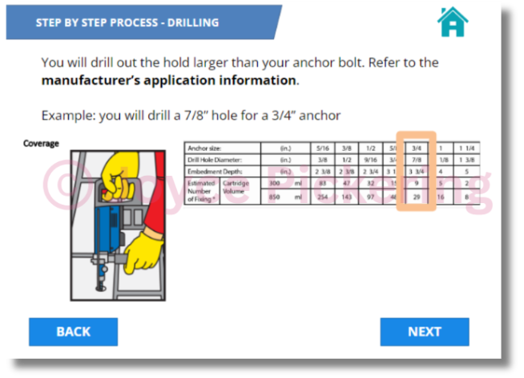
About
Education
Work Experience
Work Examples
Contact
Example # 3 : Chemical Anchors

Slide 11
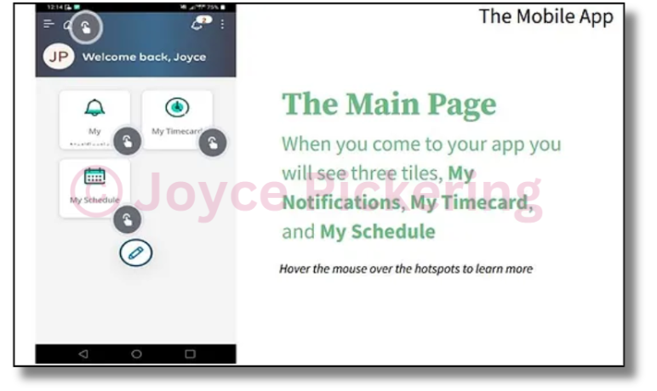
About
Education
Work Experience
Work Examples
Contact
Example # 4 : UKG Payroll Training
The Problem :
Tasked with creating an e-learning module for our new payroll system, I encountered significant obstacles:
1. The corporate training version was overly complex and irrelevant to the location.
2. Extensive customization was required to align with to specific needs.
3. Supervisor approval was delayed, risking the timely launch of the training.
4. Our department feared that an unclear training program could undermine previous progress.
These challenges necessitated a swift, targeted approach to deliver effective and relevant training to our employees.
The Design Process :
Before development, I thoroughly reviewed the corporate training version and collaborated with HR to ensure all relevant content for our location was included. With a tight 24-hour deadline, I recorded both mobile and web usage of the application, edited the footage, and produced a polished video presentation. I also added voiceovers and hosted the video on a private YouTube channel. Confident that this tailored training would match the effectiveness of the corporate version, I also created installation guides in five languages: Spanish, English, Korean, and Vietnamese.
Technology :
Genial.ly, VEED, Canva, Youtube

Slide 12
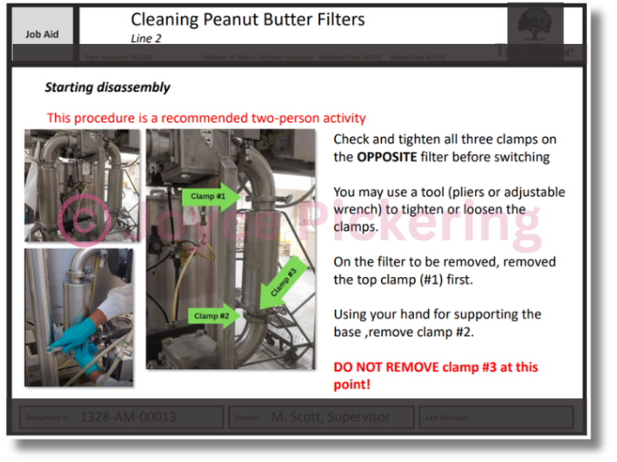
About
Education
Work Experience
Work Examples
Contact
Example 5 : Technical Writing
The Problem :
The process of consistent and accurate documentation was neglected during the time of the plant transfer to new ownership. Employees where receiving informal training from other employees and supervisors without a set frame work. This lead to inconsistent and incomplete training.
The Design Process :
Using Human-Centered Design, a framework was built out in order to decide the best way to present the information in a logical and scaffolding manner. Collaboration with SMEs was necessary to provide scope and “tribal knowledge”.
The Solution :
Using Human-Centered Design, a framework was built out in order to decide the best way to present the information in a logical and scaffolding manner. Collaboration with SMEs was necessary to provide scope and “tribal knowledge”.
Technology :
PowerPoint, Canva

Slide 13
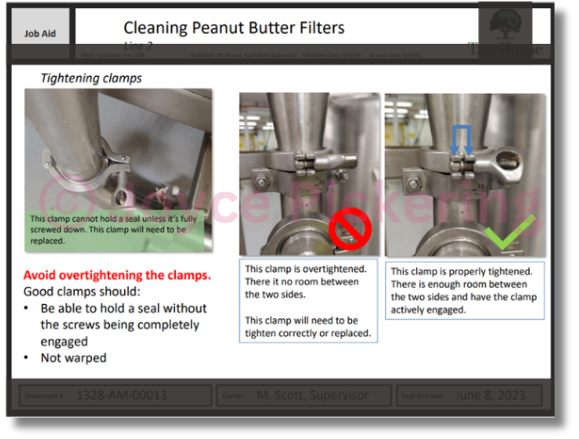
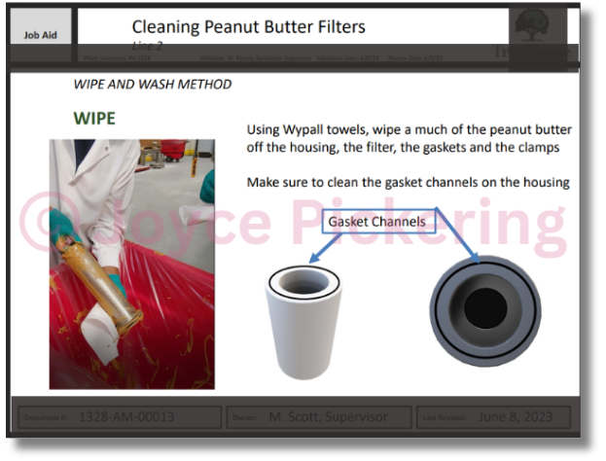
About
Education
Work Experience
Work Examples
Contact
Example # 5: Technical Writing

Slide 14


About
Education
Work Experience
Contact
Address
LET'S CONNECT
Glen Rock, PA USA
Mail
Jeapickering AT Gmail.com
Web Address
www.jpinstructionaldesign.com

